Slide 1
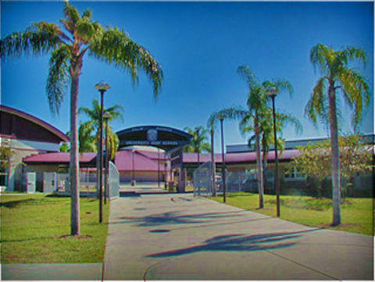
Class of 2027
Seminar

Slide 2

Meet your Counselors
University A-G: Elizabeth Ryczek
University H-O: Tim Papp
University P-Z: Amanda Madej
Medical: Erika Picard
College and Career Coordinator: Kirby Pratt

Slide 3
Know your Graduation Requirements
24 credits
Must meet all subject level credit requirements!
GPA
Minimum 2.0 unweighted
Testing
Pass Alg 1 EOC and FAST ELA

Slide 4
Testing
Must PASS FAST PM 3 Reading
OR earn a concordant score in one of the following ways:
480 on SAT EBRW
Average of 18 on ACT Reading and English
Must Pass Alg 1 EOC
OR earn a concordant score in one of the following ways:
420 SAT Math
16 ACT Math
430 PSAT Math

Slide 5
What credits do I need to graduate?
English
4 credits
Math
4 credits, must include Algebra 1 (1.0) and Geometry (1.0)
Science
3 credits, must include Biology (1.0)
Social Studies
American Government (0.5)
Economics (0.5)
US History (1.0)
World History (1.0)

Slide 6
Credits
Fine Arts
1 credit in fine/performing or CTE course
HOPE
Health Opportunities through Physical Education
OR PE through sports (2 years JV or Varsity-same sport) form must be signed and input into your course history

Slide 7

COLLEGE ACADEMIC EXPECTATION
This Photo by Unknown Author is licensed under CC BY-SA-NC

Slide 8
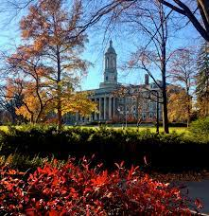
4 Year College/University Requirements
In addition to HS Grad requirements you must take:
Algebra 2
2 or 3 years of foreign language (consecutive, same language)
Recommendation:
take foreign language throughout HS
take advanced coursework (AP, DE, AICE, Honors)
take additional math and science courses (as advanced as you can)

Slide 9
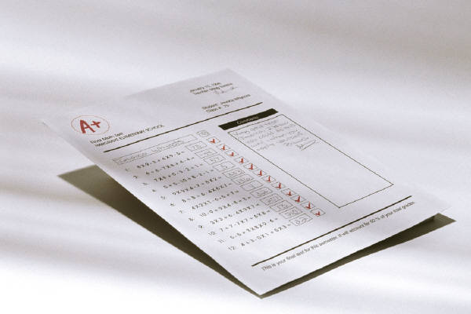
ACADEMIC PROGRESS

Slide 10
GRADING SYSTEM
QUESTION | ANSWER
What do I earn for passing a class? | .5 credit per semester Credit earned in any class you receive a “D” or higher as your final grade (per semester)
How many credits can I earn in one year of high school? | 3.5 credits are possible per semester = 7.0 credits per year (if all classes passed )
How are final grades calculated? | Two grading periods per semester plus a final exam (if not exempted) are averaged together to calculate final semester grade
What is the Exemption Policy? | Is Attendance and Grade driven See School Website for Criteria
1ST
2ND
FINAL
EXAM
FINAL

Slide 11
MYTH vs. FACT
As long as I just get by with doing as little as possible and pass all my
classes with a “D,” I will be able to fulfill all my requirements to graduate. -- MYTH
FACT: It is not easy to simply raise a low GPA

Slide 12



TUTORING
OPTIONS
This Photo by Unknown Author is licensed under CC BY

Slide 13
Need Help?
Math homework help Tuesdays 2:05-4:05 room 19-103 all math levels
  Fridays 2:00-3:00 room 19-232 Alg 1 & 2, MCA, MCLA
Make appointment to stay after with your teacher other subjects
Homework helpline: 727 547 7223, staffed by teachers 5-8pm Mon-Thurs
eCounselor: eCounselor@pcsb.org, staffed by counselor to answer questions M-F 5-9pm
After school credit recovery ELP- academic classes only
  TBD—will start registering students soon-see counselor
  You MUST attend if you failed any core classes to recover credit and get on track for graduation

Slide 14

Credit Recovery/Grade Forgiveness
You MUST recover graduation requirement classes if you receive an F
You SHOULD recover graduation requirement classes if you receive a D
How?
  After school credit recovery (ELP)
When?
  Mondays through Thursdays from 2:00-4:00pm **Start date TBD**
Where?
  PHUHS room TBD
  Students typically finish a course in about 22 hrs. Varies student to student.
SEE COUNSELOR TO SIGN UP!

Slide 15



Homework/Studying
Doing your homework and studying are essential!
Tips
  create a study plan (quiet place, time of day, how long?)
  manage your time
  get in a routine
  ask for help! (HW helpline, parents, khan academy, etc.)

Slide 16
Naviance
Naviance is a customizable planning portal for students and families including self-discovery assessments, goal-setting, college research tools, and career exploration resources.
On Naviance, you can take a career interest inventory, complete a resume, search for colleges and explore a variety of post-secondary options.
Introductory Naviance video: https://www.screencast.com/t/tbcYt9eUkKg
Logging into Naviance
  Log into Clever and select the Naviance icon. You can also type “Naviance” into the search bar.
  Once you are in Naviance, scroll down to see your “Important To Dos and Tasks” and begin working on those. You can also click on “Planner” in the top tool bar and select “Tasks” to see what is required for you to work on.

Slide 17

Naviance Tasks
Game Plan Survey
4 Year Plan Review
Achieveworks Personality
  These tasks will provide a reminder of Naviance, its purpose, and how they will use it throughout the course of their high school career. Students will identify their thoughts and feelings about transitioning to high school.

Slide 18
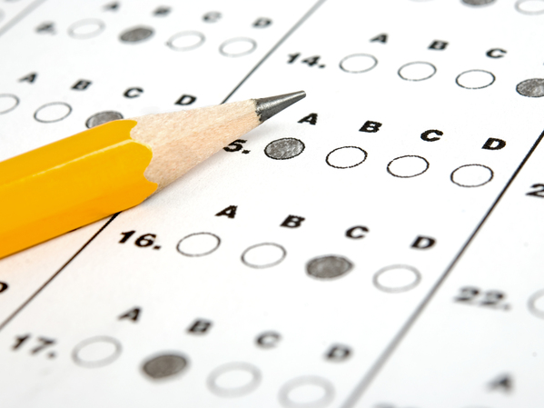
PSAT
All 9th graders will take new digital PSAT
October 2nd and 3rd
Additional Resources:
  www.SATpractice.org
  www.collegeboard.org
This Photo by Unknown Author is licensed under CC BY-ND

Slide 19
PSAT: Benefits
Prepares you for the SAT (preliminary SAT)
Can be used to satisfy Alg 1 EOC requirement (if met concordance)
Provides your personalized strengths and areas that need improvement- link to www.satpractice.org for personalized SAT prep
Important to take as a Junior
  To qualify for National Merit Scholarship
  To qualify for additional scholarships:
    Telluride Association
    National Hispanic Recognition Award
    National Scholarship Service

Slide 20

BRIGHT FUTURES
http://www.floridastudentfinancialaid.org/SSFAD/bf/

Slide 21
4 levels
All require:
  Volunteer or paid work hours (different amount for each)
  4 credits English
  4 credits Math (Alg 1 and higher) –if you are in Alg 1 now will need additional credit
  3 credits Science
  3 credits Social Studies
  2 credits World Language (sequential, same language!)
  SAT/ACT scores

Slide 22
Bright Futures, how do I volunteer?
Step 1: Find a place to volunteer; call/email and set your schedule
Step 2: Log into Profferfish through Clever and submit your volunteer organization for approval or see if already approved
Step 3: track your hours then submit once completed on Profferfish
Step 4: Verify volunteer supervisor checking email to verify volunteer hours

Slide 23
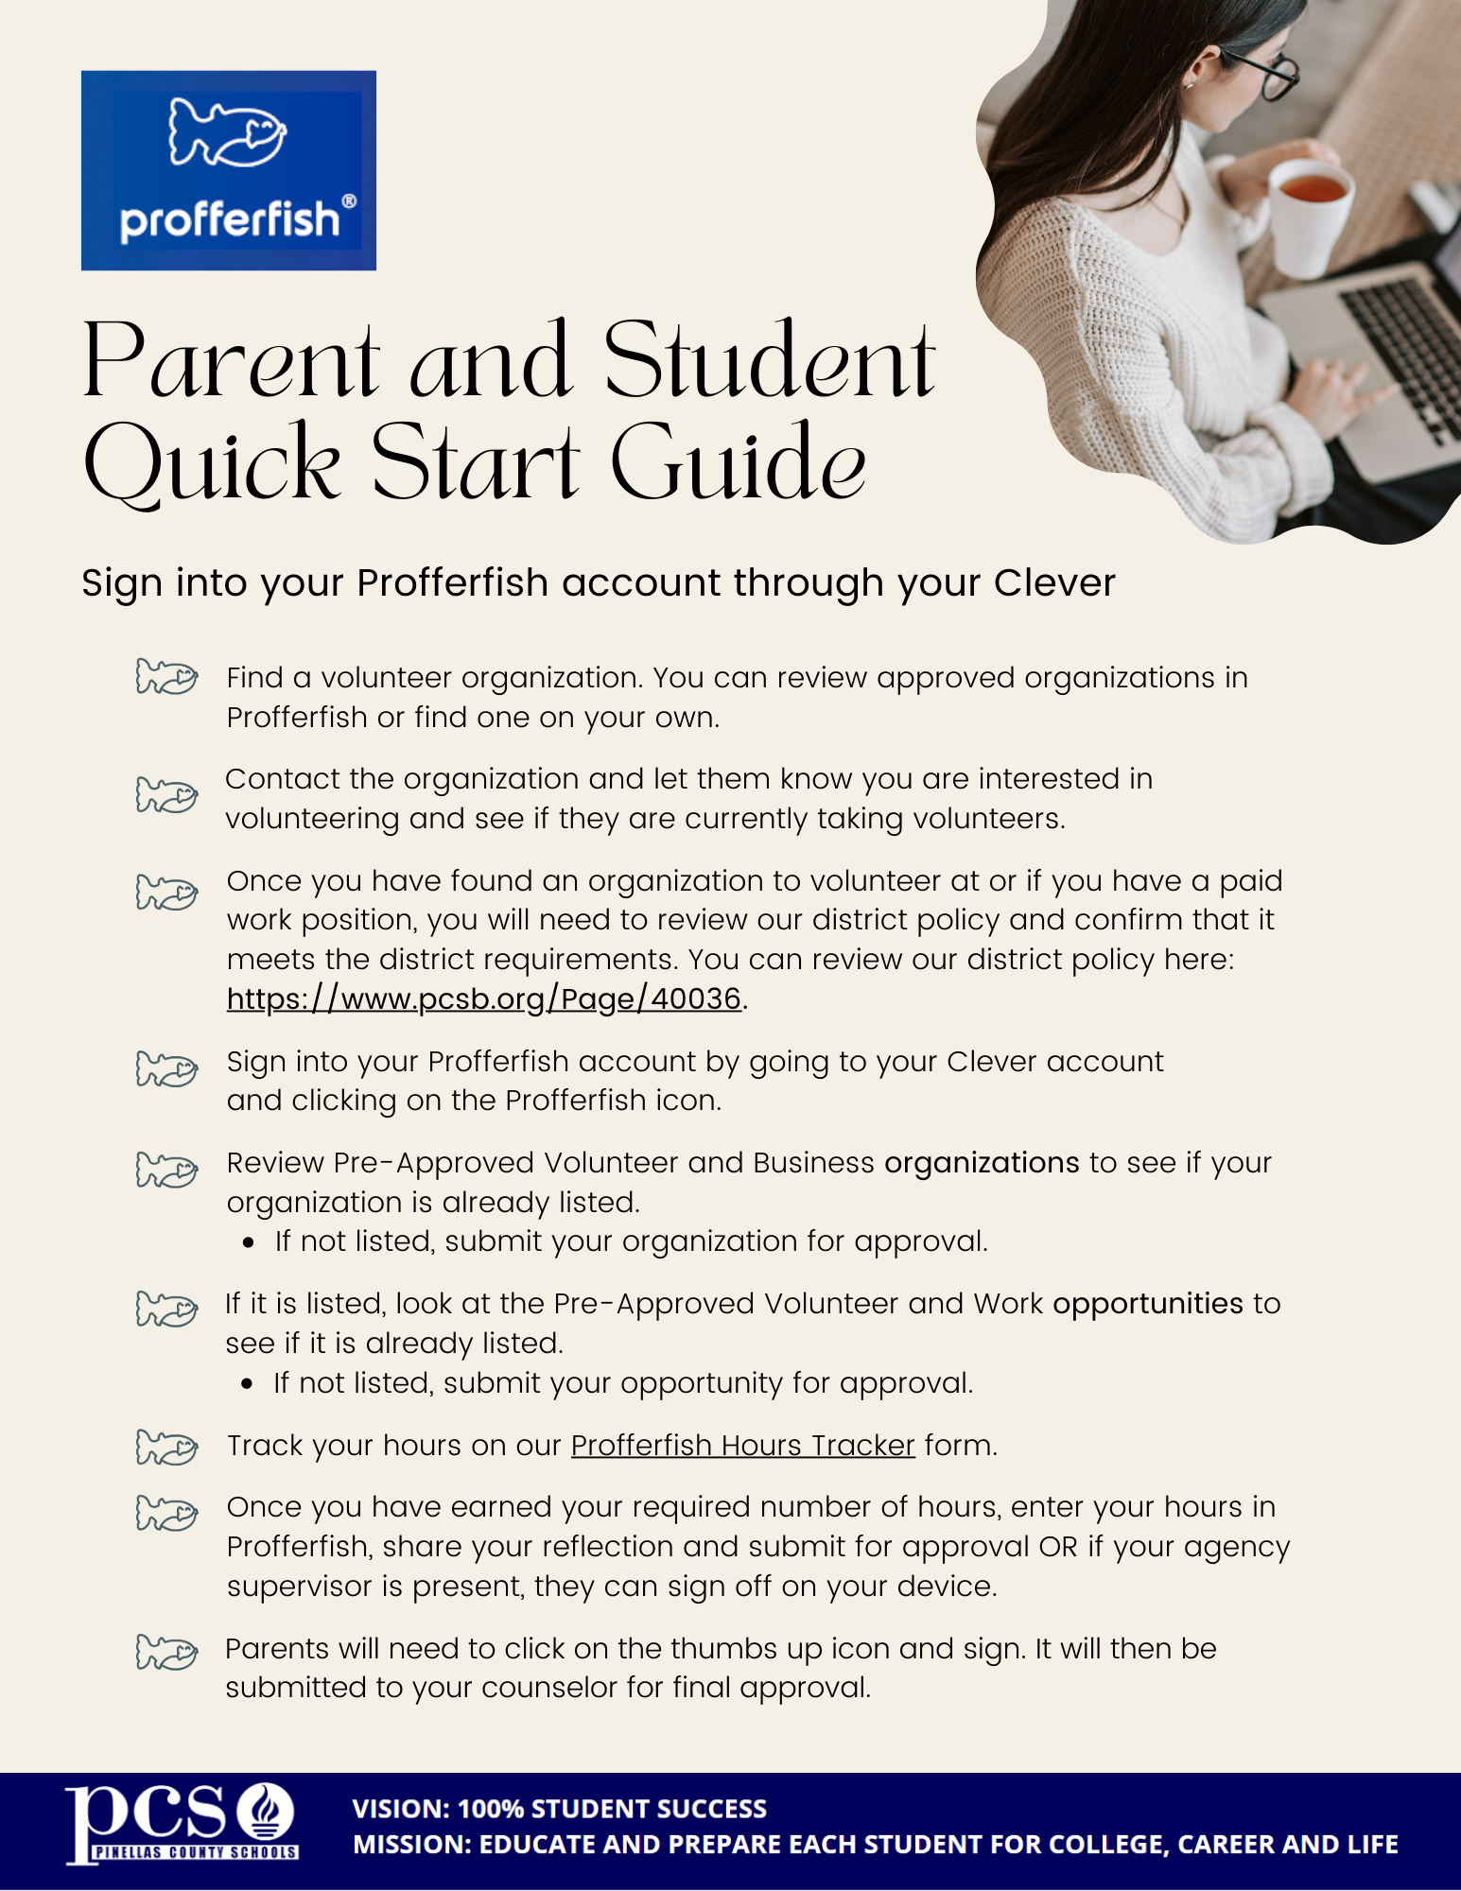

Slide 24

Dual Enrollment
Earn college credits for free!
St. Petersburg College offers college classes to qualified high school students in Pinellas County at no charge! These courses give students credits toward a high school diploma and a college degree. Courses are available on SPC campuses and some local high school campuses.
What's required to enroll
3.0 unweighted cumulative GPA
Satisfactory scores on the College Placement Test (PERT) or SAT/ACT/PSAT
TO RESEARCH FURTHER:
https://www.spcollege.edu/future-students/admissions/high-school-programs

Slide 25
Early College Program
Earn college credits for free!
A unique partnership between St. Petersburg College and Pinellas County Schools
The Early College Program offers college credit hours as well as high school credit at no cost to highly motivated students in grade 11. Earn as many as 60+ credits towards a 4-year bachelor's degree through participation in the Early College Program.
Who is eligible?
Students entering grade 11
What's required?
A 3.0 unweighted cumulative GPA or higher.
Satisfactory scores on the PERT or SAT/ACT/PSAT

Slide 26
Early Admissions
Start college early - for free!
St. Petersburg College offers early college admission to qualified high school students in Pinellas County at no charge! This program gives students credit toward a high school diploma and a college degree.
Earn as many as 30+ credits towards a 4-year bachelor's degree through participation in the Early Admission Program.
Who’s eligible?
Students entering the 12th grade
What’s required to enroll?
3.0 unweighted cumulative GPA
Qualifying scores ACT/SAT/PSAT or PERT
Pass FAST ELA and Alg EOC
Take and pass Bio, Geo, HOPE, World Hist

Slide 27



Looking for post secondary information?
Scholarships
Bright Futures
SAT/ACT
FAFSA
Technical Careers
Military
College
bit.ly/PHUHSCCR
(case sensitive)

Slide 28
Fall 2023 College Visits
September Visits
9/1- University of Central Florida
9/5- Amherst College
9/7- University of Chicago
9/14- Valdosta State University
9/18- Troy University
9/19- University of Miami
October Visits
10/3- University of Florida
10/5- University of Alabama Birmingham
10/6- American University
10/13- Furman University

Slide 29
Communication
Stay up to date on important announcements and upcoming events
  School website: www.pcsb.org/phuhs
  Weekly update emails (goes to parents)
  University student Padlet: https://padlet.com/madeja/university-student-padlet-wci6imj5weyvz2pv

